Slide 1

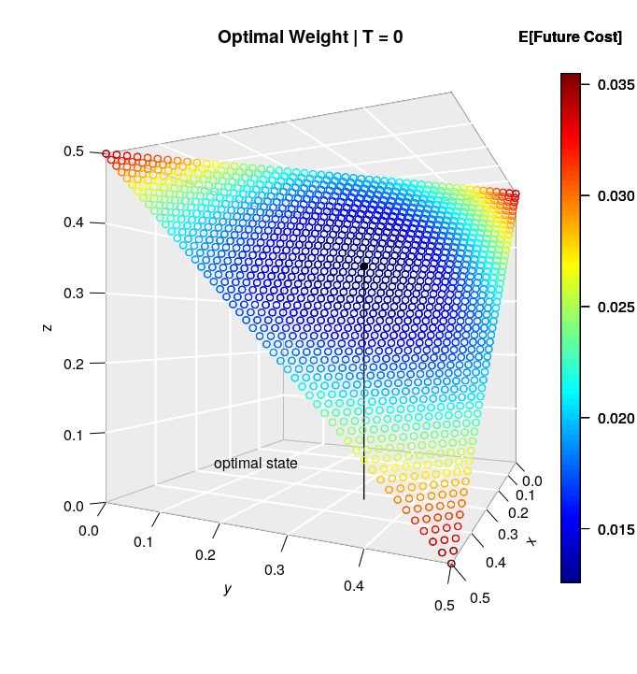
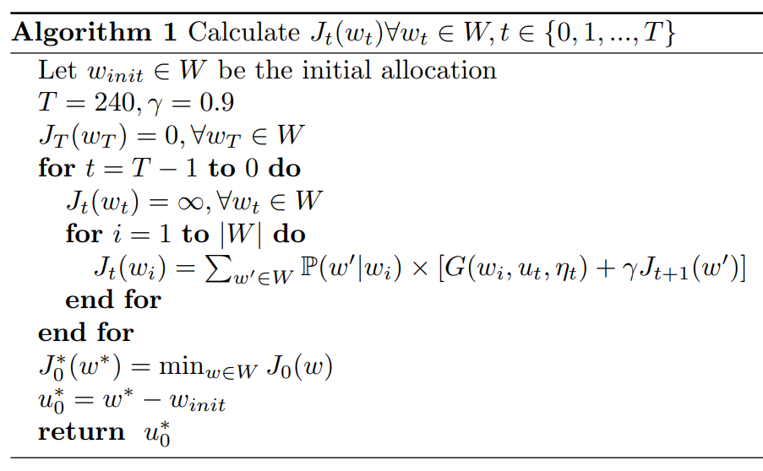
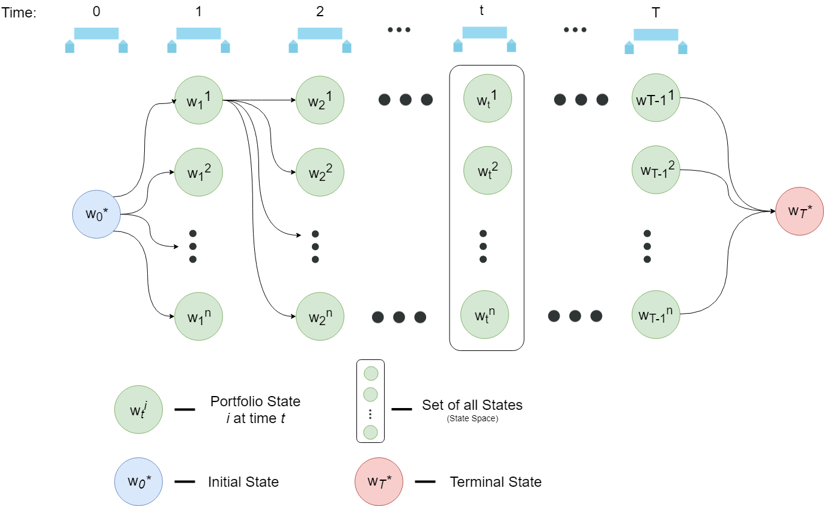


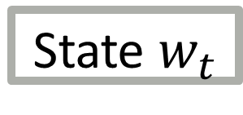
Optimal Portfolio Rebalancing using Reinforcement Learning John-Craig Borman, Professor Somayeh Moazeni
Pinnacle Scholars Summer Research Program 2018
The Portfolio Rebalancing Problem
Portfolios, like their underlying assets, have risk and return characteristics that naturally evolve over time with the market
Rebalancing helps investors successfully navigate a portfolio across market regimes given a particular risk/return based objective
The objective of the portfolio rebalancing problem is to make a decision at each point in time to rebalance or not while minimizing costs sustained by the portfolio
Reinforcement learning provides the ideal modelling and optimal solution framework to a problem commonly solved by heuristics in the investment management industry
Computational Results
Q-Learning can deal with the cures of dimensionality as the number of assets $N$ grows
Actions: Rebalancing Decisions ($u$)
State Variable: Portfolio Allocation ($w$)
Stage Cost:
$$G\left(w_{t},u_{t},η_{t}\right)=τ\left(w_{t}, u_{t}\right)+ε(w_{t}, w_{t+1})$$
$τ\left(w_{t}, u_{t}\right)$ - Transaction Costs
$ε(w_{t}, w_{t+1})$ – Tracking Error
State Variable Costs
The Model
Given a portfolio of $N$ assets with portfolio weights $w^{∗}=\left[w_{1}, …, w_{N}\right]$, our goal is to maintain a portfolio that tracks the target portfolio as closely as possible while minimizing transaction costs
The portfolio can be rebalanced every month
Normal returns are assumed:
$w_{t+1}=(1+η_{t})(w_{t}+u_{t})$, where $η_{t}\sim N(μ,σ)$
The objective to be minimized is the sum of (i) tracking error, (ii) transaction costs, (iii) expected future costs
State $w_{t}$
Conclusion
Reinforcement learning provides an objective optimal decision as a solution while heuristic methods provide ad-hoc sub-optimal decisions
The solution model can be flexibly adapted to meet an investor’s unique constraints
Future research should look to implement the reinforcement learning model with alternative assumptions to the normal multiplicative dynamic model as well as higher dimensional portfolios
Methodology: Reinforcement Learning
References
Sutton, Richard S., and Andrew G. Barto. Reinforcement Learning: an Introduction. The MIT Press, 2012.
Jaconetti, Colleen M, et al. Best Practices for Portfolio Rebalancing. Vangaurd, July 2010.
Sun, Walter, et al. “Optimal Rebalancing for Institutional Portfolios.” Journal of Portfolio Management, vol. 32, no. 2, 2006, pp. 33–43.
Davis, Joseph H, et al. The Asset Allocation Debate: Provocative Questions, Enduring Realities. 2007, The Asset Allocation Debate: Provocative Questions, Enduring Realities.
Brinson, Gary P., L. Randolph Hood, and Gilbert L. Beebower, 1986. Determinants of Portfolio Performance. Financial Analysts Journal 42(4): 39–48.
Pula, Justina & Berisha, Gentrit & Ahmeti, Skender. (2012). The Impact of Portfolio Diversification in the Performance and the Risk of Investments of Kosovo Pension Savings Trust. Journal of Business and Economics.

